Slide 1



Revolutionizing Career Guidance with AI
Personalized AI guidance, skill assessment, and global mentorship for a brighter future.
The Sector Commanders
Presented By

Slide 2



group members
Tasbir Iqbal
Md. Nafij Hejaji
Abul Hasnat Mohammad Istiaqullah
Md Mahabubur Rahman
Rakibul islam

Slide 3


Introduction
The Comprehensive Career Guide is a transformative digital platform designed to revolutionize global career guidance. By integrating AI, machine learning, and advanced data analytics, the system provides:
01
Personalized Recommendations: Data-driven career paths tailored to individual profiles
02
Skill Assessments: Comprehensive evaluations to identify and bridge professional gaps.
03
Scalable Mentorship: Intelligent matching for meaningful professional connections.

Slide 4

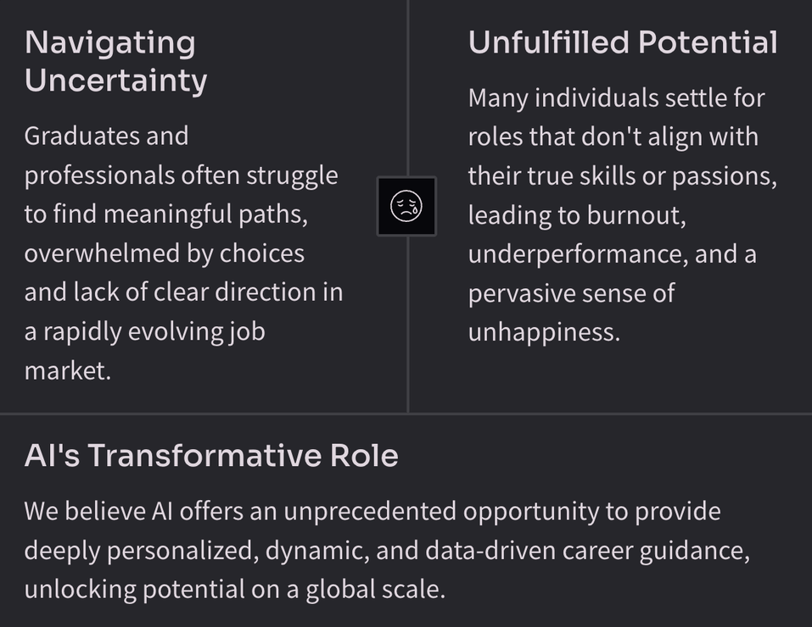
Motivation
Our journey began with a clear vision: to address the profound challenges faced by individuals navigating complex career landscapes. We identified key areas where traditional approaches fall short, leading to widespread dissatisfaction and missed opportunities.

Slide 5

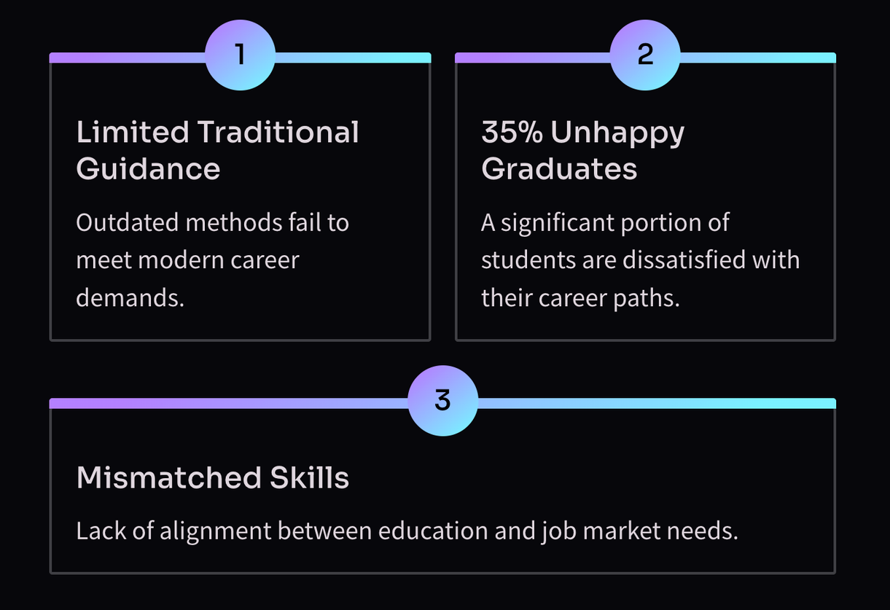
The Critical Problem: Unhappy Graduates

Slide 6
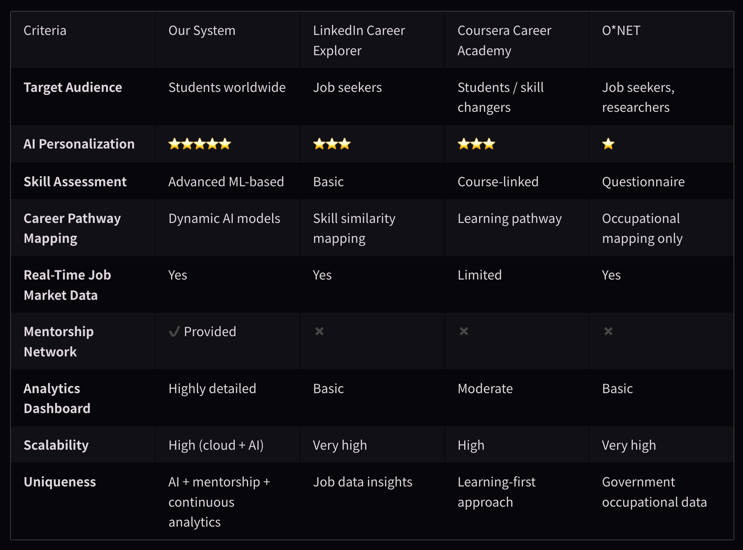
Benchmark study

Slide 7

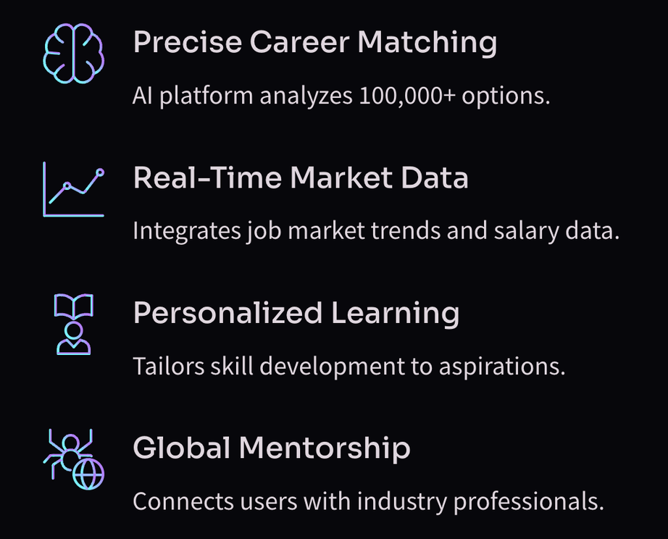
Project Scope and Features

Slide 8


Tools / Languages
  Frontend & Mobile: React
  Backend & Data: Python, mySQL,
  AI : TensorFlow, PyTorch, AWS, Azure

Slide 9

Thank You

